Slide 1
MILP Model for Aggregate Planning
Decision variables:
workforce level
hired and laid-off
production level
inventory level
subcontracted units
backlogged units
overtime hours
These decisions have to be made for each time period

Slide 2
MILP Model for Aggregate Planning
Objective function:
Minimize the total cost (consists of the following costs)
Regular-time
Overtime
Hiring and laying off
Inventory holding
Backorder
Material
Subcontracting
Constraints:
Workforce level (for each time period)
Inventory balance (for each time period)
Production capacity (for each time period)

Slide 3
Example
Nivia Inc. that makes several models of skateboards has to plan its production for the next 4 months. The demand information and other details are given in the below tables. One unit requires 4 hours of labor. Every month has 20 working days and the regular working hours is 8 hours per day. The overtime in a month is limited to 200 hours. Workforce level at the beginning of Month 1 is 5. Initial and ending inventory are to be zero and no backorder at the end of month 4. There is no backorder at the start of the planning horizon. Prepare the aggregate plan.
Month | 1 | 2 | 3 | 4
Forecast | 1600 | 1400 | 3000 | 2400
Head | Cost (Rs)
Regular time cost | 50/hr
Overtime cost | 75/hr
Subcontracting cost | 600/unit
Inventory holding cost | 40/unit/month
Backorder cost | 300/unit/month
Hiring cost | 6000/worker
Laying off cost | 10000/worker
Cost of materials | 200/unit

Slide 4
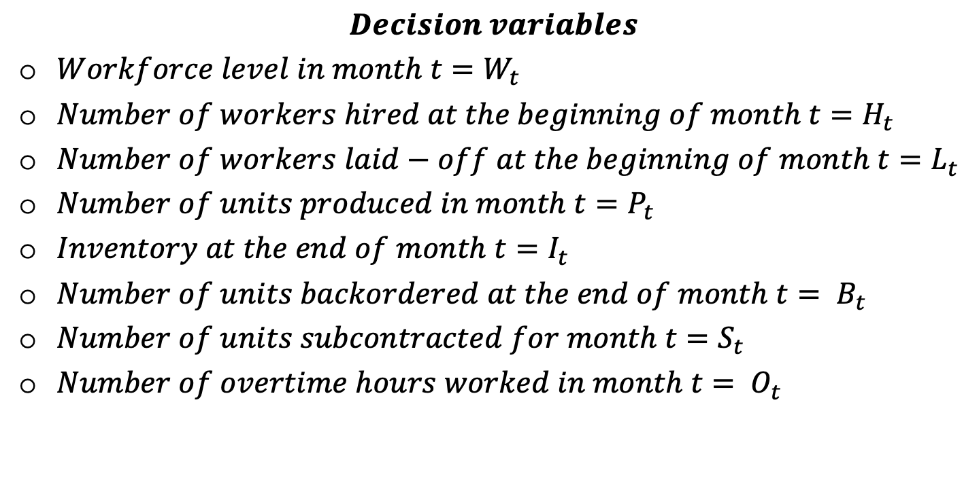
Aggregate Planning Example
$$Decision variables$$
$Workforce level in month t=W_{t}$
$Number of workers hired at the beginning of month t=H_{t}$
$Number of workers laid−off at the beginning of month t=L_{t}$
$Number of units produced in month t=P_{t}$
$Inventory at the end of month t=I_{t}$
$Number of units backordered at the end of month t= B_{t}$
$Number of units subcontracted for month t=S_{t}$
$Number of overtime hours worked in month t= O_{t}$

Slide 5
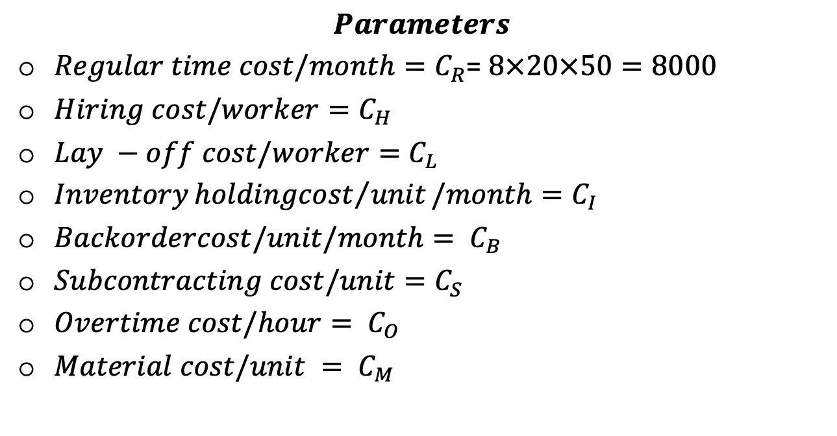
Aggregate Planning Example
$$Parameters$$
$Regular time cost/month=C_{R}$= $8×20×50=8000$
$Hiring cost/worker=C_{H}$
$Lay −off cost/worker=C_{L}$
$Inventory{holdingcost}/{unit}/month{=C}_{I}$
$Backordercost/unit/month= C_{B}$
$Subcontracting cost/unit=C_{S}$
$Overtime cost/hour= C_{O}$
$Material cost/unit = C_{M}$

Slide 6
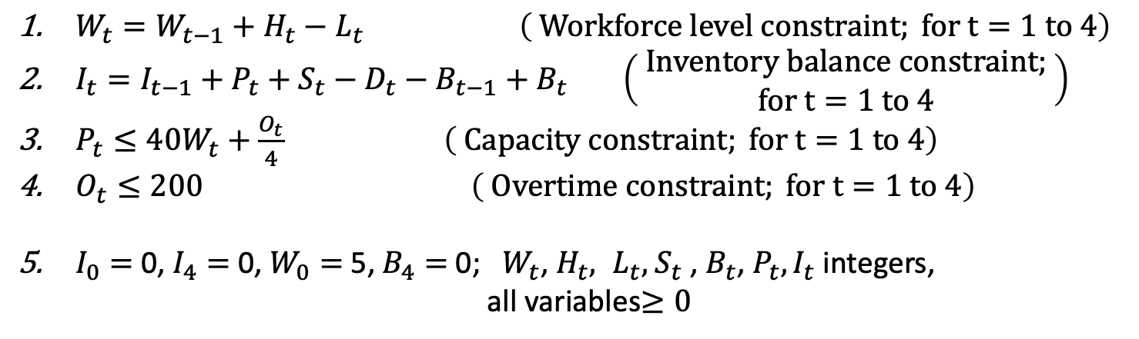

Aggregate Planning Example
Objective:
$$Minimize Z=$$
$$C_{R}\sum_{t=1}^{4}{W_{t}}+C_{H}\sum_{t=1}^{4}{H_{t}+C_{L}\sum_{t=1}^{4}{L_{t}+}}C_{I}\sum_{t=1}^{4}{I_{t}+C_{O}\sum_{t=1}^{4}{O_{t}+C_{B}\sum_{t=1}^{4}{B_{t}}}+}C_{S}\sum_{t=1}^{4}{S_{t}+C_{M}\sum_{t=1}^{4}{P_{t}}}$$
Constraints:
$W_{t}=W_{t−1}+H_{t}−L_{t} \left( Workforce level constraint; for t=1 to 4\right)$
$I_{t}=I_{t−1}+P_{t}+S_{t}−D_{t}−B_{t−1}+B_{t} \left(\begin{aligned} Inventory balance constraint; \\ for t=1 to 4\end{aligned}\right)$
$P_{t}≤40W_{t}+\frac{O_{t}}{4} \left( Capacity constraint; for t=1 to 4\right)$
$O_{t}≤200$ $\left( Overtime constraint; for t=1 to 4\right)$
$I_{0}=$ 0, $I_{4}=$ 0, $W_{0}=$ 5, $B_{4}=$0; $W_{t}$, $H_{t}, L_{t},$ $S_{t}$, $B_{t}$, $P_{t}, I_{t}$ integers,
all variables$≥0$

Slide 7
Aggregate Plan
Month | No. Hired | No. Laid off | Workforce size | Overtime | Inventory | Backorder | Subcontract | Total production | Demand
0 | 0 | 0 | 5 | 0 | 0 | 0 | 0
1 | 35 | 0 | 40 | 0 | 0 | 0 | 0 | 1600 | 1600
2 | 16 | 0 | 56 | 0 | 840 | 0 | 0 | 2240 | 1400
3 | 1 | 0 | 57 | 0 | 120 | 0 | 0 | 2280 | 3000
4 | 0 | 0 | 57 | 0 | 0 | 0 | 0 | 2280 | 2400
Total cost | 3710400
For details and the excel file solution, see “Aggregate planning.xlsx”, sheet 1

